Slide 1
Getting started with SharePoint Framework
Setup Office 365 tenant

Slide 2
Agenda
Configurations to Office 365 tenant
Verifying configuration
Q&A

Slide 3
Configurations to Office 365 tenant

Slide 4
Office 365 Developer Tenant Setup Steps
Sign up for an Office 365 Developer Tenant
Create app catalog site
Create a new site collection for testing – dev or normal
Use online workbench for testing your code
http://aka.ms/spfx-setup-tenant

Slide 5
Sign up for an Office 365 Developer Tenant
Sign up for the Office Developer Program
You will receive welcome mail with link to sign up for Office 365 tenant
http://dev.office.com/devprogram
Notes:
To build and deploy client-side web parts using the the SharePoint Framework, you will need an Office 365 Tenant.

Slide 6
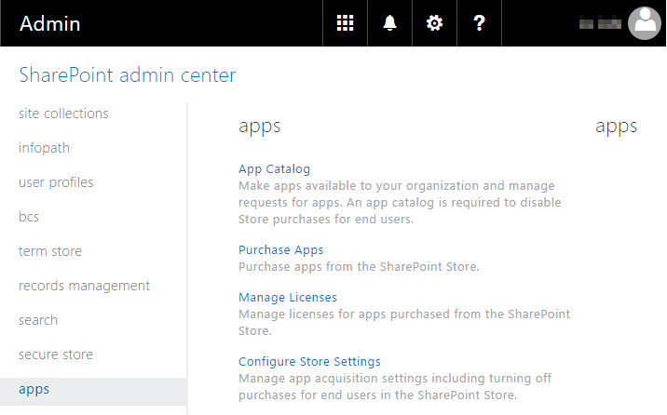
Create app catalog site
https://yourtenantprefix-admin.sharepoint.com
SharePoint Framework solutions are deployed to tenant using app catalog when they are ready for distribution

Slide 7
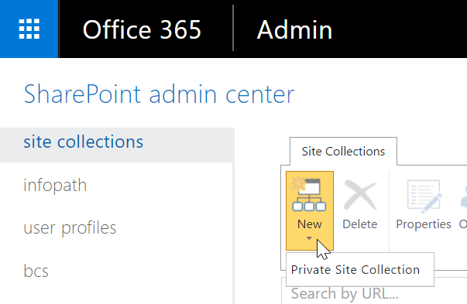
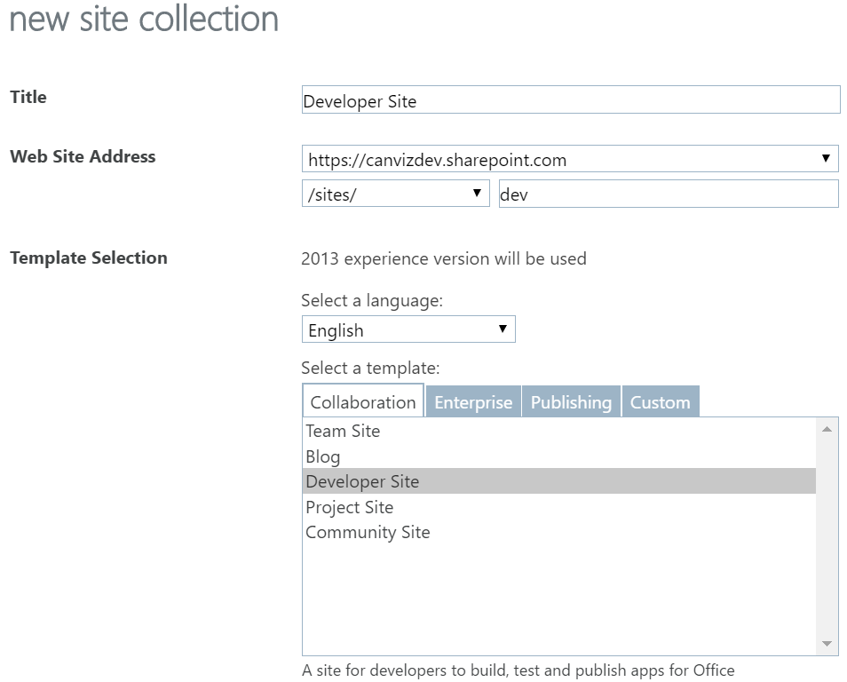
Create a new Developer Site collection
https://yourtenantprefix-admin.sharepoint.com
Technically developer site collection is targeted for add-in development, but you need to have a location to test web parts from SharePoint Framework Online workbench

Slide 8
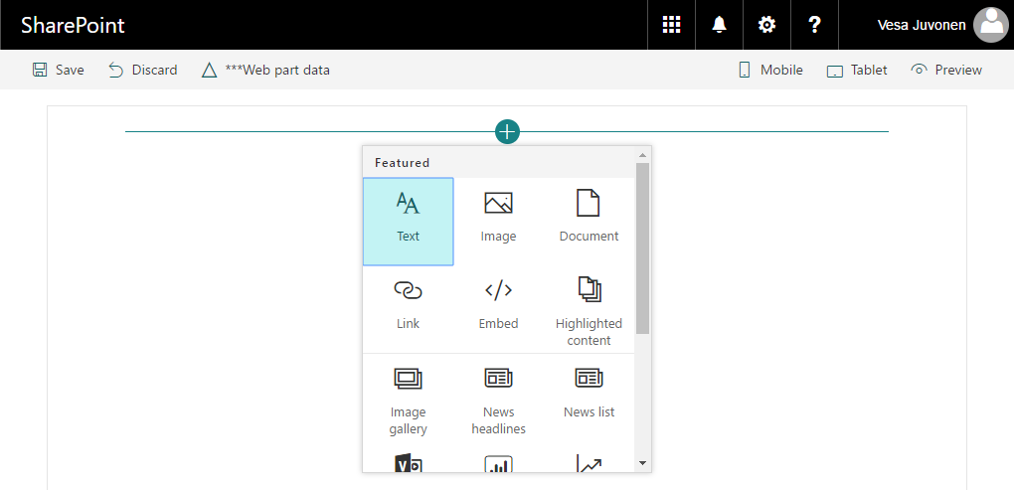
SharePoint workbench
SharePoint Online workbench can be accessed under any site with _layouts URL. Hosted site provides you site context where solution is executed.
https://your-sharepoint-site/_layouts/workbench.aspx

Slide 9
DEMO
Configuring Your Office 365 Environment and verifying setup with sample web part

Slide 10
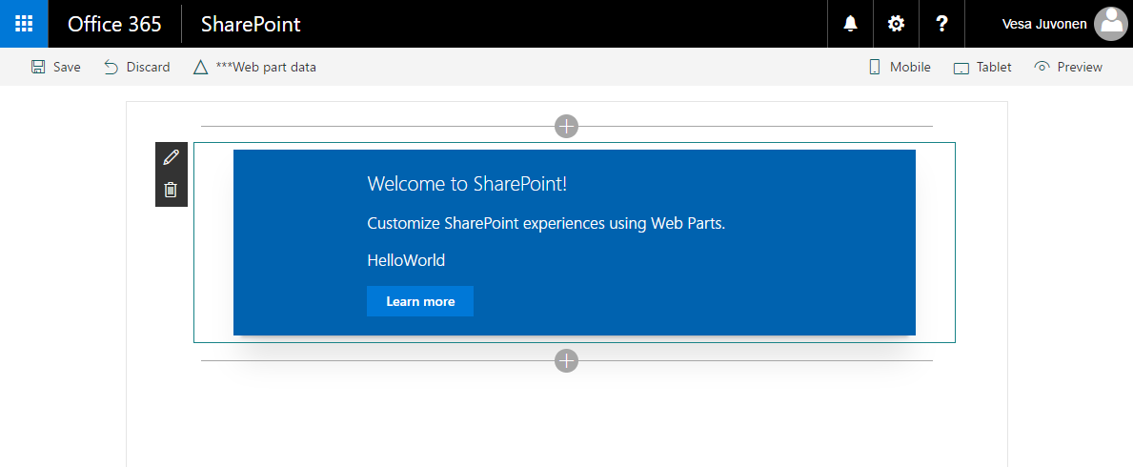
Verify It All Works
Install Hello World client-side web part and test

Slide 11
Verifying configuration

Slide 12
DEMO
Verifying Configuration

Slide 13
Summary
Configurations to Office 365 tenant
Verifying configuration
Q&A

Slide 14

Sharing is caring…
Code samples and solutions
Reusable components
Guidance documentation
Monthly community calls
SharePoint Framework
SharePoint add-ins
Microsoft Graph
Office 365 APIs
http://aka.ms/SharePointPnP

Slide 15

Q&A

Slide 16


